Slide 1



Dust: using simulations to understand the evolution in observations
Collaboration: Stefan van der Giessen (UGhent, UGR), Ilse De Looze (UGhent), Monica Relaño Pastor (UGR), Kosei Matsumoto (UGhent), Kentaro Nagamine (UOsaka), Hiroyuki Hirashita (IAA Taiwan), Leonard Romano (Garching)
Stefan.stefananthonyvandergiesse@ugent.be

Slide 2
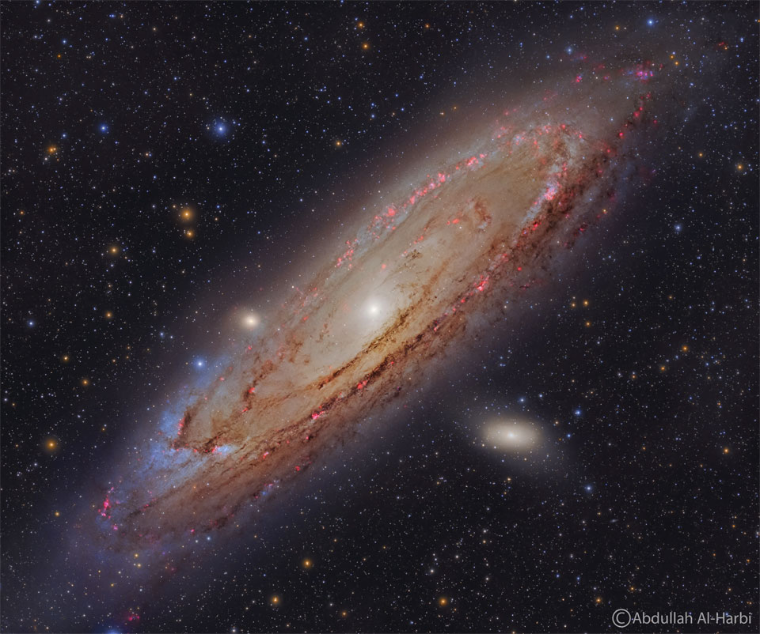

Slide 3
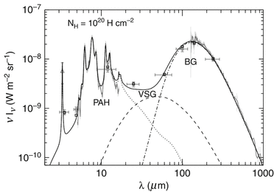

Dust life cycle within galaxies
PAHs: hydrogenated carbon features
Very Small Grains: grains < ${10}^{−3}μm$
Big Grains: grains > ${10}^{−3}μm$
Tielens et al. (2013)

Slide 4
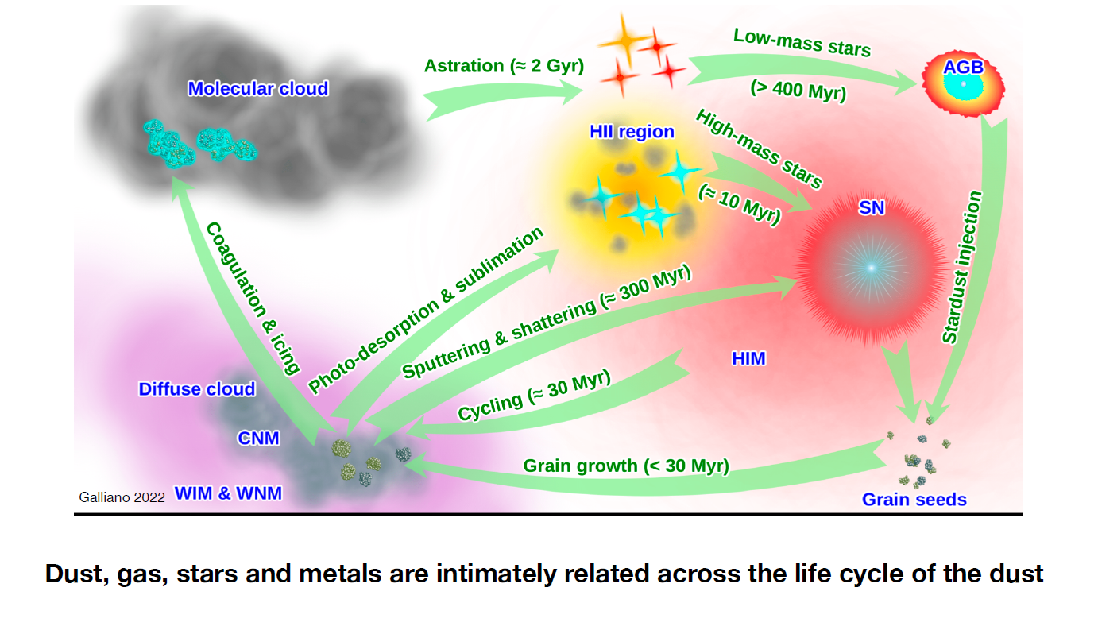
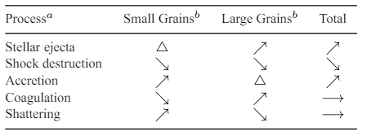
Dust life cycle within galaxies
Hirashita (2015)

Slide 5
Dust life cycle within galaxies
Hirashita (2015)

Slide 6
Dust life cycle within galaxies
Hirashita (2015)

Slide 7
Dust life cycle within galaxies
Hirashita (2015)

Slide 8
Dust life cycle within galaxies
Hirashita (2015)

Slide 9
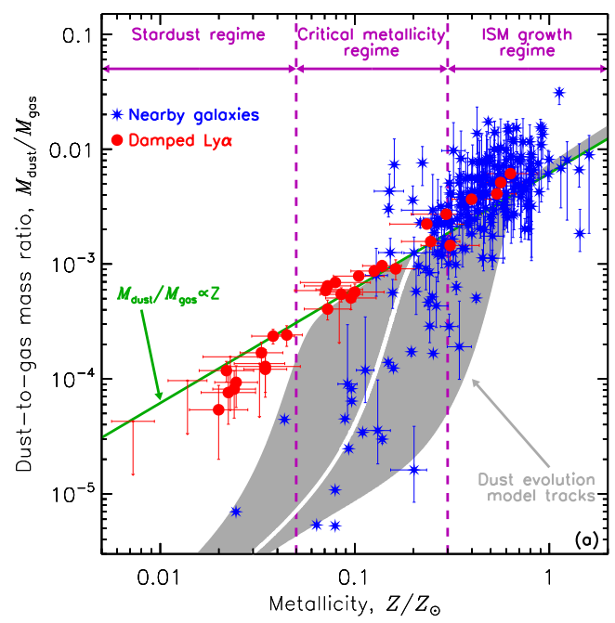

Dust and metals: true partners in crime
DGR ratio varies strongly with metallicity
Slope changes at 0.3$Z_{⊙}$
Dust growth?
Galliano et al. (2018)

Slide 10
Questions
What is the primary driver for dust growth?
How does grain size evolve with the dust evolution?
What determines the critical metallicity?
What drives the maximum number of metals in dust?

Slide 11
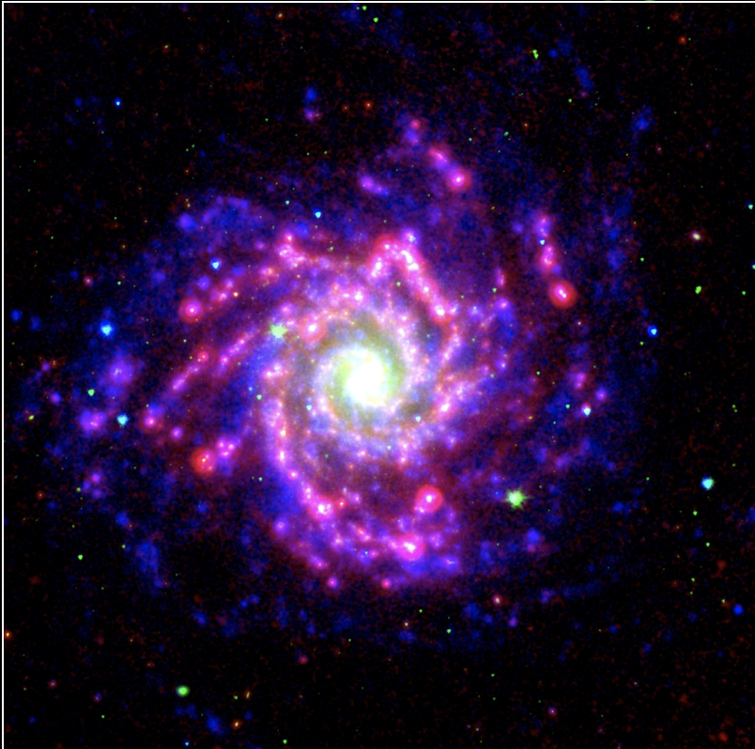
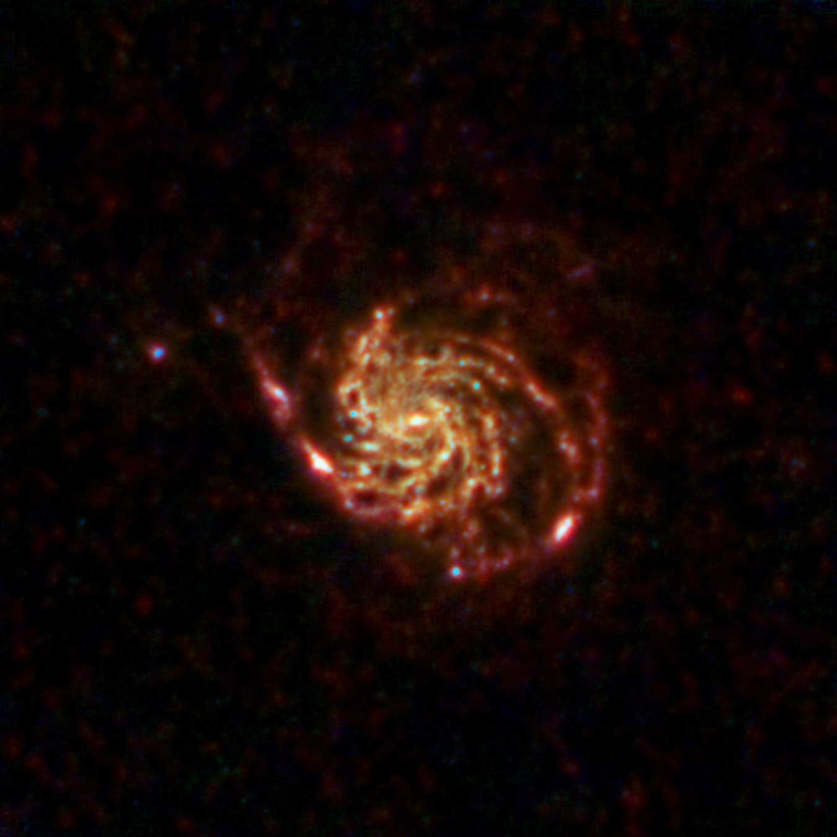
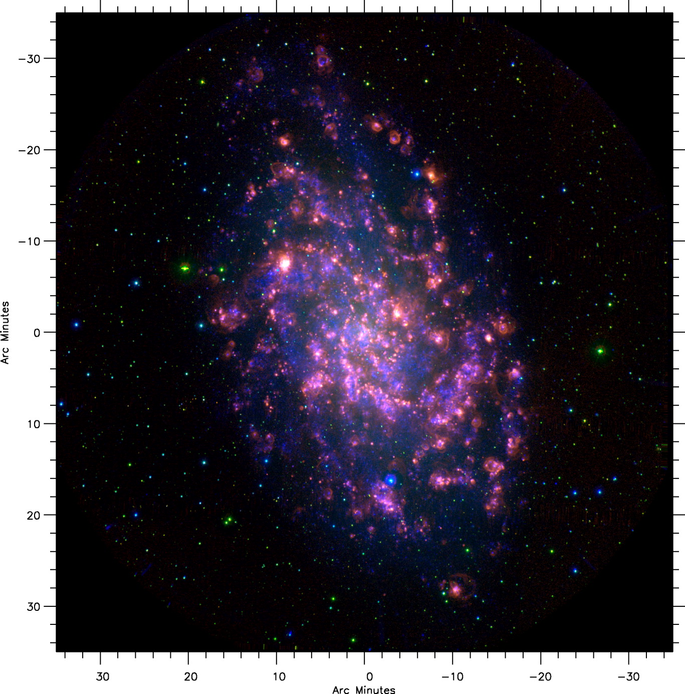
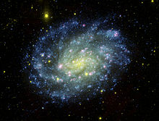
Observations
NGC 628
M101
NGC628 and M101, M33, and NGC300
  Well-studied by e.g., Vilchéz et al. (2019), Relaño et al. (2020), Chiang et al. (2021)
M33
NGC 300

Slide 12
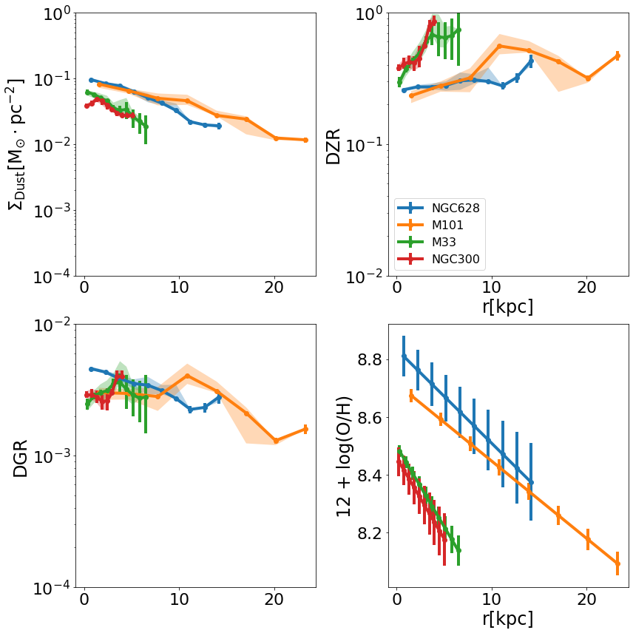
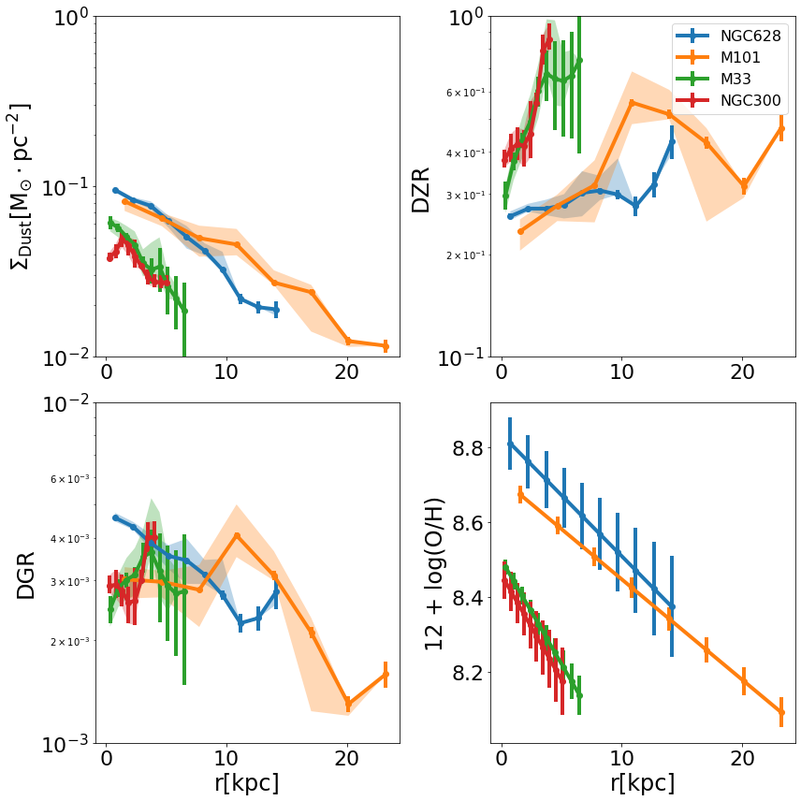
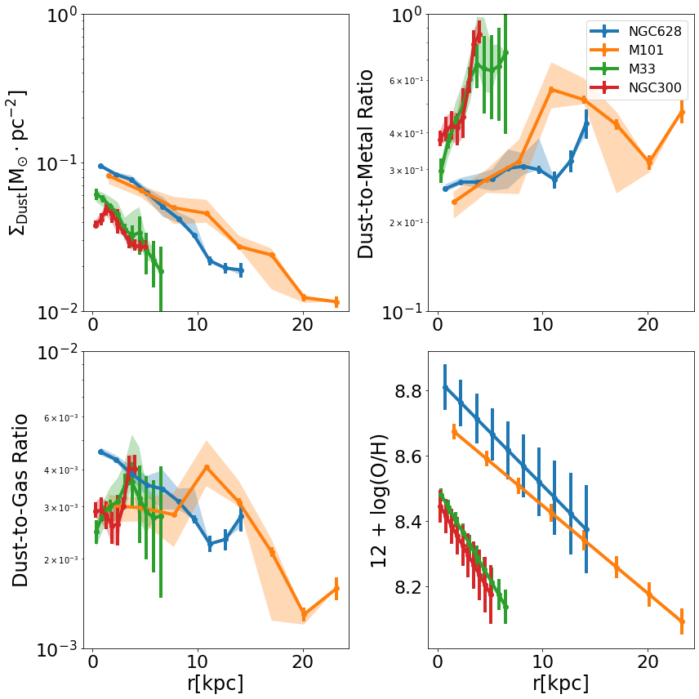
Observations
NGC628 and M101, M33, and NGC300
  Radial profiles in stars, gas, and SFR well-constrained
Big differences in dust radial profiles, oxygen abundance, and dust-scaling relations
Van der Giessen et al. (in prep)

Slide 13
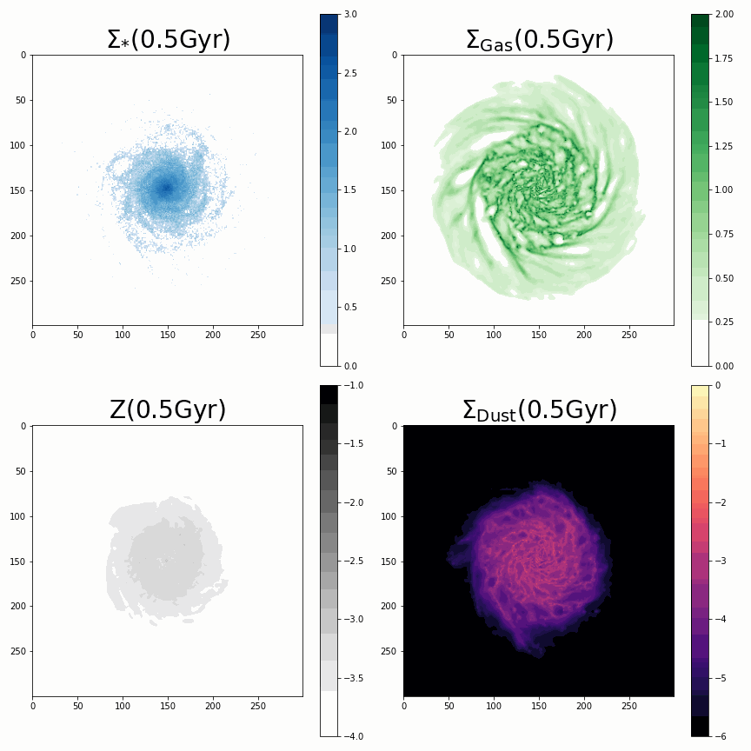
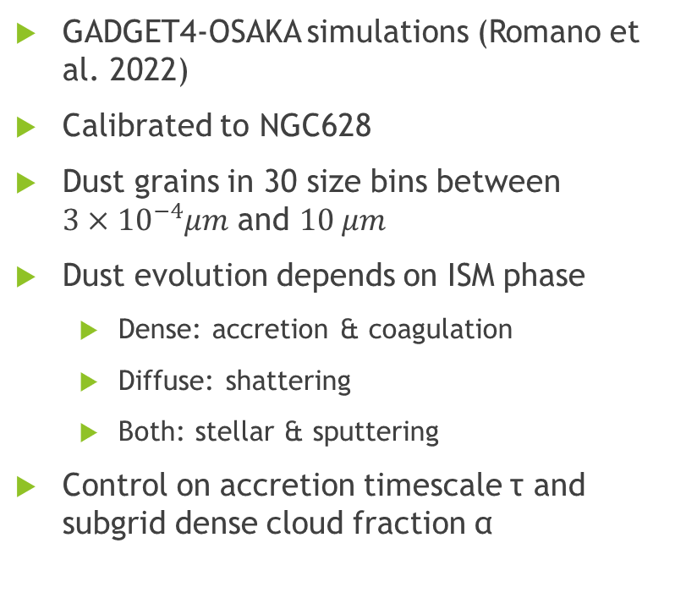
Simulations
GADGET4-OSAKA simulations (Romano et al. 2022)
Calibrated to NGC628
Dust grains in 30 size bins between ${3×10}^{−4}μm$ and $10 μm$
Dust evolution depends on ISM phase
  Dense: accretion & coagulation
  Diffuse: shattering
  Both: stellar & sputtering
Control on accretion timescale τ and subgrid dense cloud fraction α
Van der Giessen et al. (in prep)

Slide 14
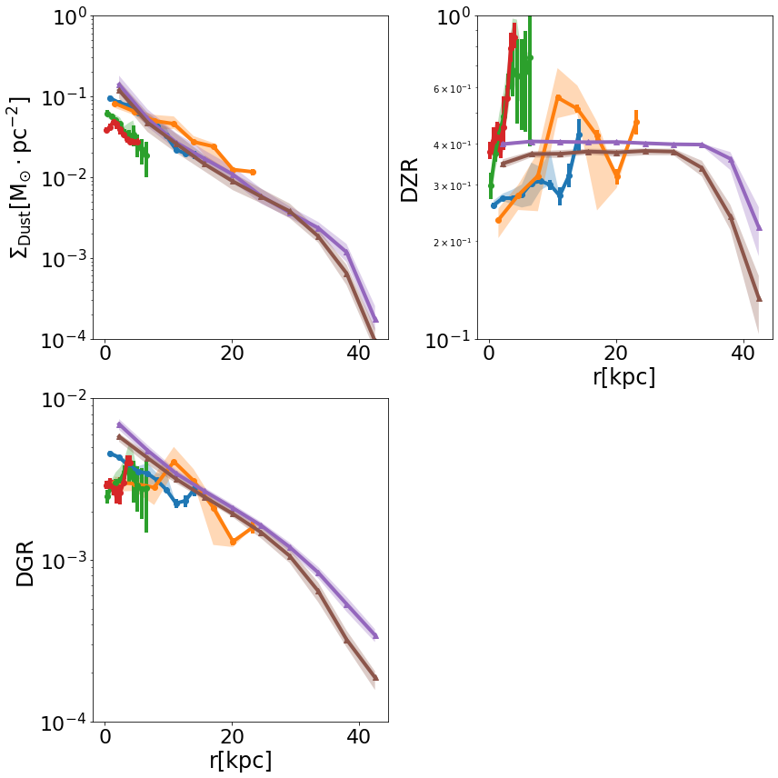
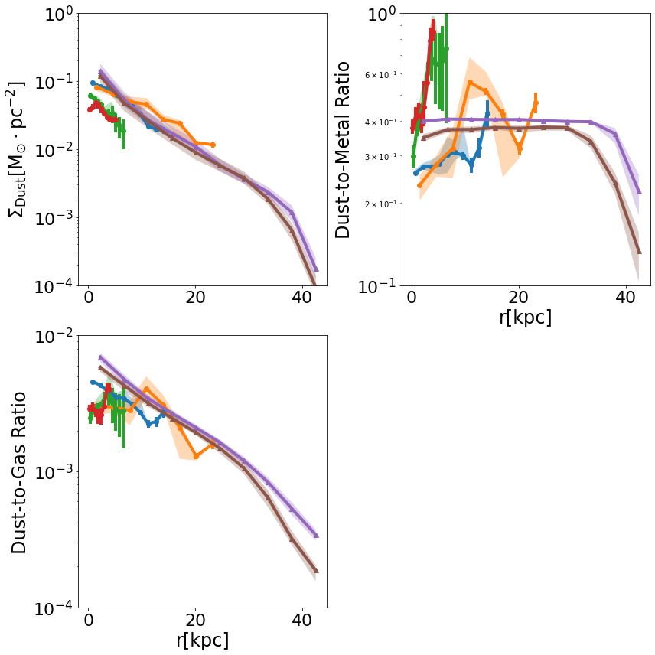
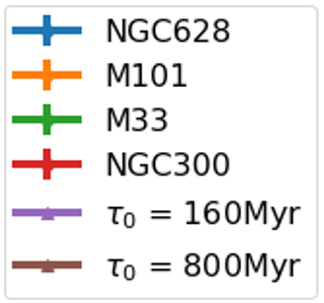
Simulations with different accretion timescales
Can recreate radial profiles
  Including dust
All potential metals are locked up into dust
Van der Giessen et al. (in prep)

Slide 15
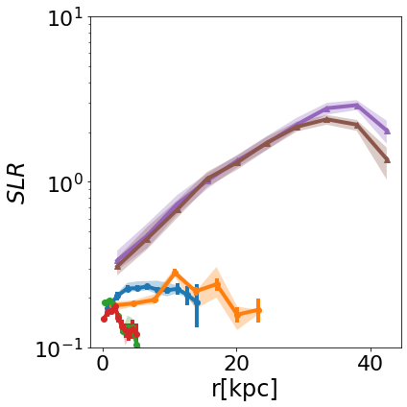
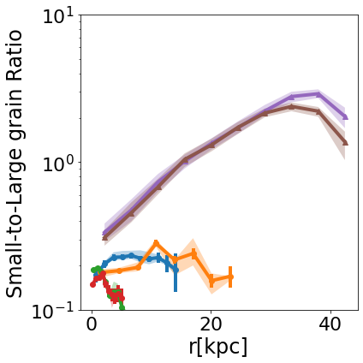
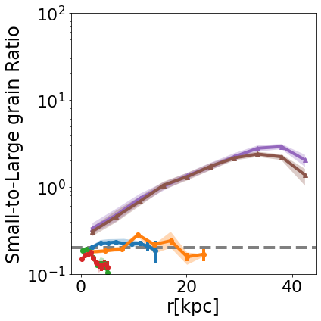
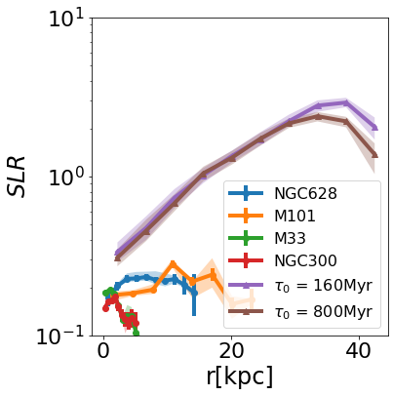
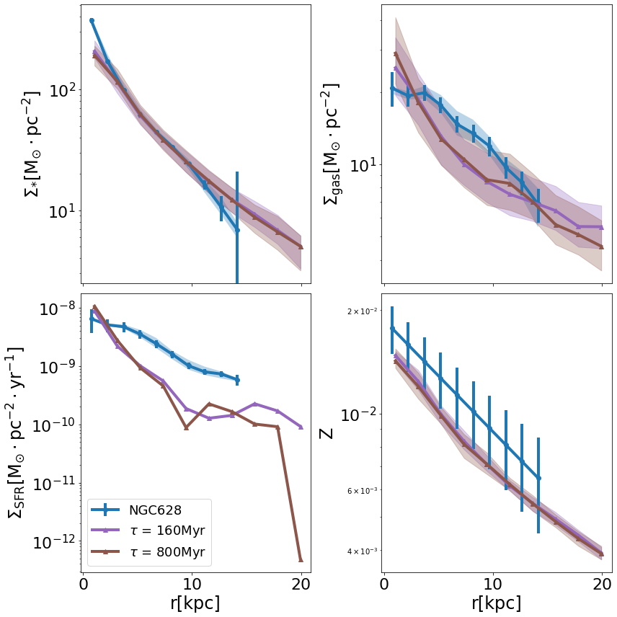
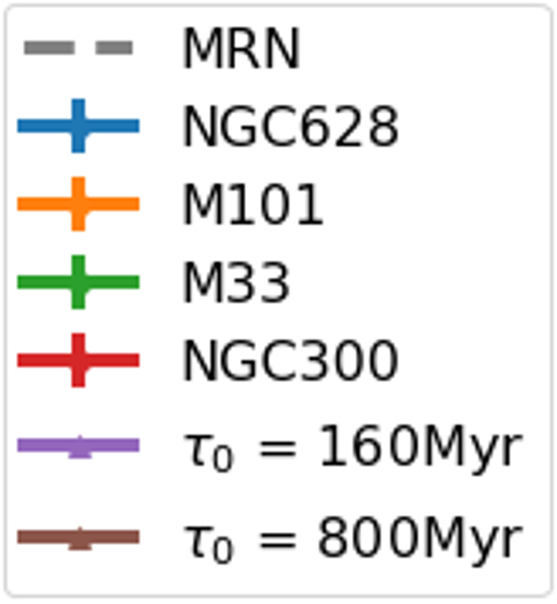
Simulations with different accretion timescales
Can recreate radial profiles
  Including dust
All potential metals are locked up into dust
Too many small grains
Van der Giessen et al. (in prep)

Slide 16
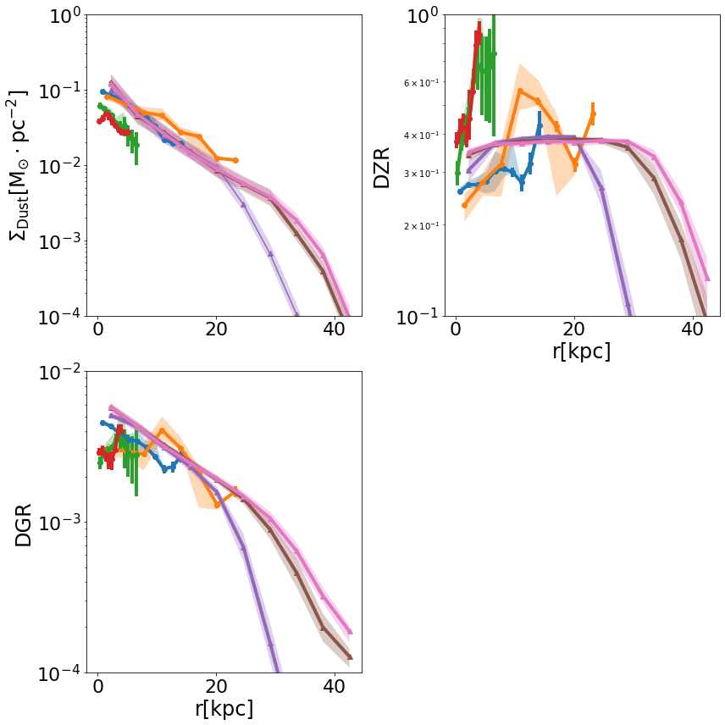
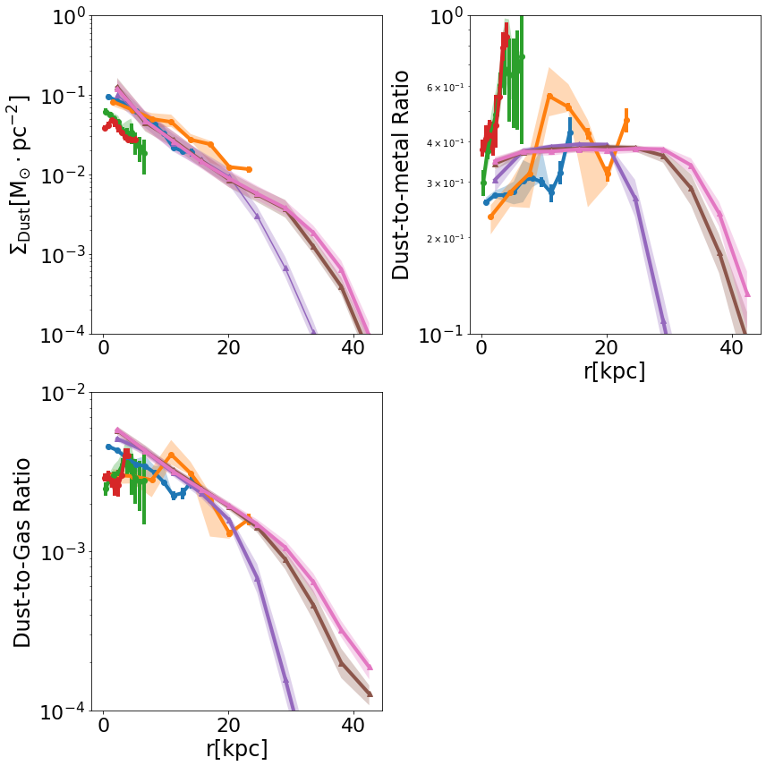
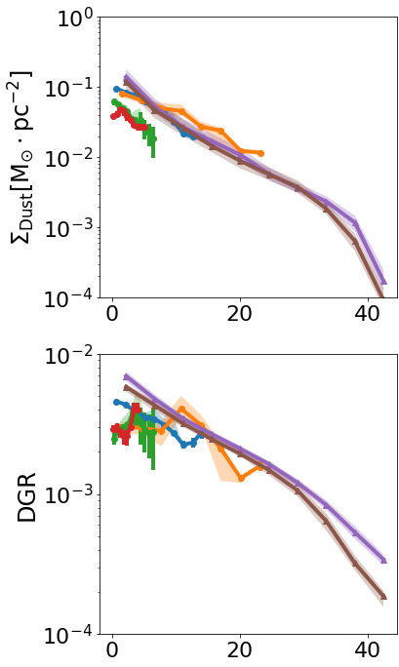
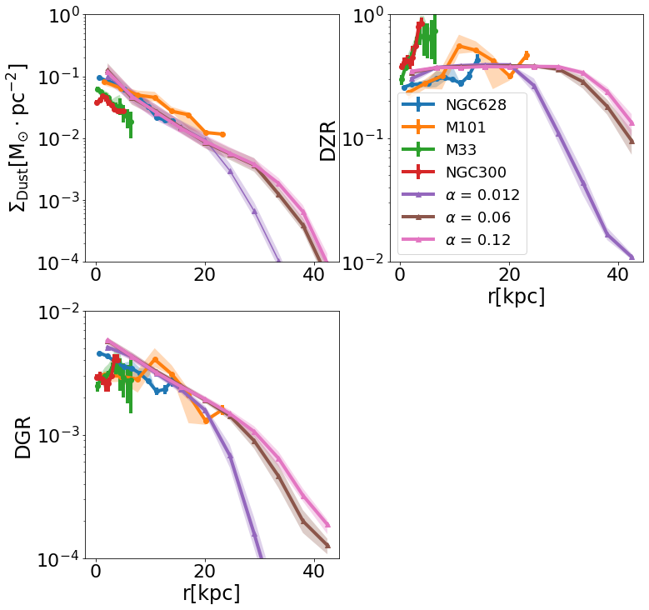
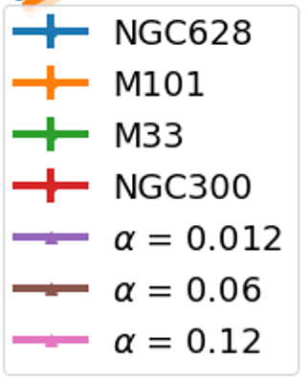
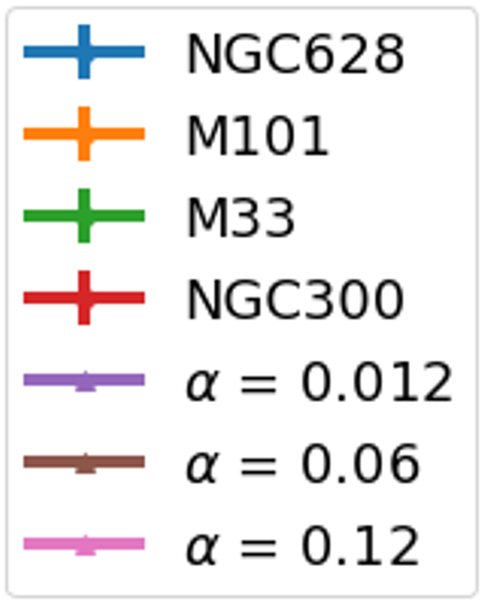
Simulations with different dense gas fractions
Can recreate radial profiles
  Including dust
All potential metals are locked up into dust
Too many small grains
Dense-vs-diffuse fraction regulates dust growth
Van der Giessen et al. (in prep)

Slide 17
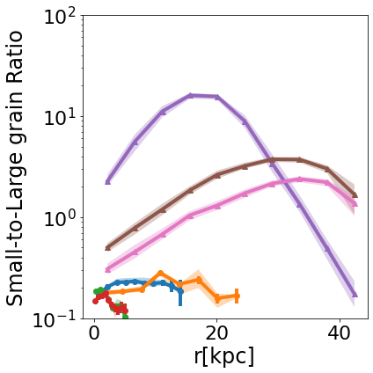
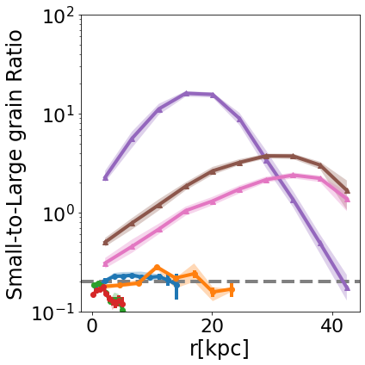
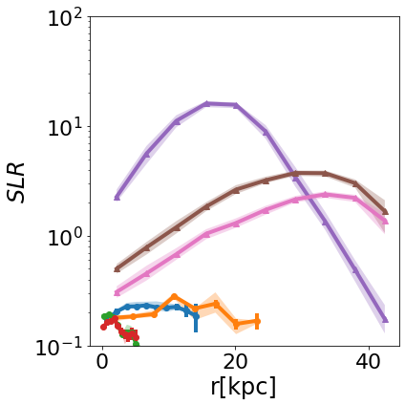
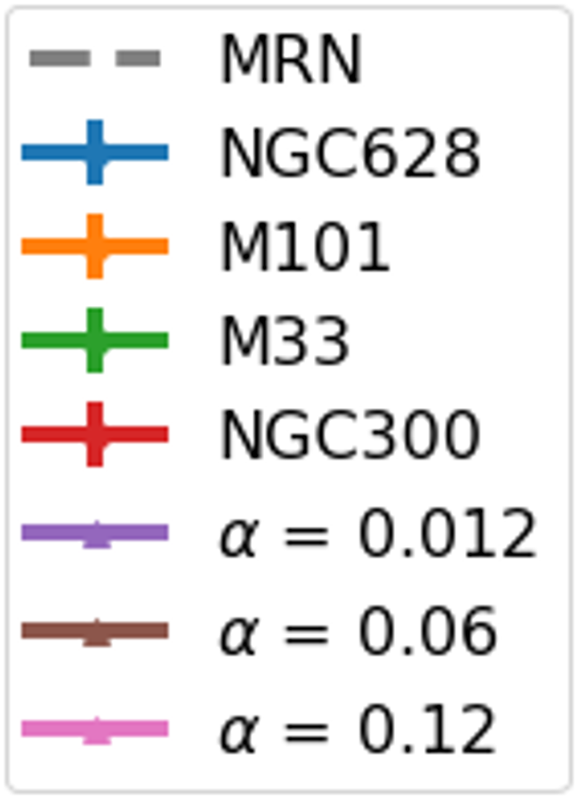
Simulations with different dense gas fractions
Can recreate radial profiles
  Including dust
All potential metals are locked up into dust
Too many small grains
Dense-vs-diffuse fraction regulates dust growth
Van der Giessen et al. (in prep)

Slide 18
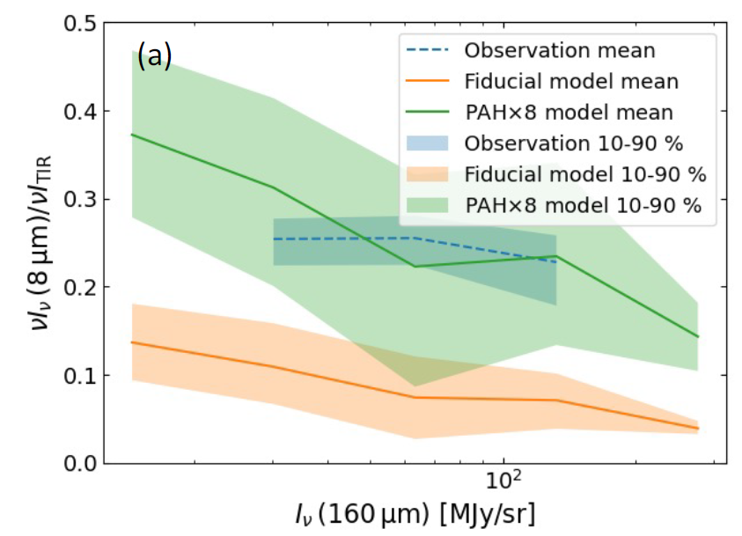
PAH fraction
Simulations produce too much small grains
Amount of PAH sized grains is underestimated
Matsumoto et al. (2024)

Slide 19
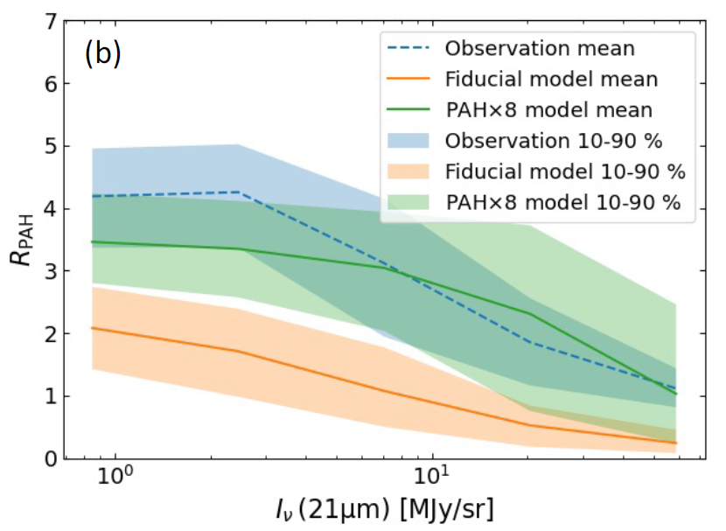
PAH fraction
Simulations produce too much small grains
Amount of PAH sized grains is underestimated
Matsumoto et al. (2024)

Slide 20
Conclusion
Calibrated isolated galaxy simulation successfully reproduces gas, dust and metal scaling relations in NGC628.
Most metals locked into dust -- implying efficient grain growth with short accretion timescales
Simulations over-predict small grain size (significantly!)
  But under-predicts amount of mass in PAH grains!
Need a more realistic cloud subgrid model and/or revise diffusion processes/grain shattering efficiencies.

